Slide 1
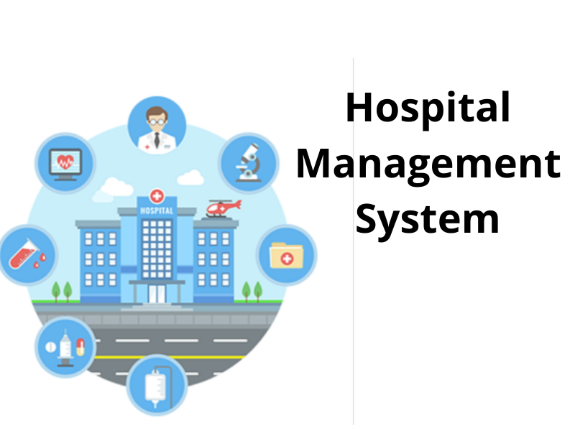

Slide 2

TEAM-3
Deepa Nagarajan 2529979
Devii Rethinavel 2526745
Gandham Hemanth 2529155
Gattamaneni Mounika 2528173
Gaurav Singh 2525943
Gowtham Sukumar 2527413
Guru Vignesh K 2529082
Hanumantha Reddy 2525460
Himanshu Kumar 2525831
Ishavardhini K 2526781

Slide 3
contents
Introduction
Why hospital management system ???
Objectives
Tools & Technologies used
System Requirements
App Flow
Features Available
Future Scope & Improvement
Conclusion

Slide 4
INTRODUCTION
It is a system enabling hospitals to manage information and data related to all doctors and patients.
Which includes registration, logging, view, approve, reject, delete of patients and doctors, storing their details into the system.
The Hospital Management System can be allow using their own username and password
The user can search the availability of doctor and their details of a patient using the id

Slide 5
WHY HOSPITAL MANAGEMENT SYSTEM ?
The purpose of this project is to computerize all details regarding patient details and hospital details. It enables doctors and admin to view and modify appointments schedules if required.
The system will be used as the application that serves hospitals, clinic, dispensaries or other health institutions.

Slide 6
OBJECTIVES
Design a system for better patient care.
Reduce hospital operating costs.
Provide MIS report on demand to management for better decision making.
Better co-ordination among the different departments.
Provide top management a single point of control.
Reduced human intervention for paperwork, less paperwork, reduced staff headcount for jobs that can be easily managed within the HMS, speedier processes, reduction of errors, and data privacy and safety.
Hospital Management System enables you to develop your organization and improve its effectiveness and quality of work.

Slide 7
HOSPITAL MANAGEMENT SYSTEM MODULES
Admin Module
Doctor Module
Patient Module

Slide 8
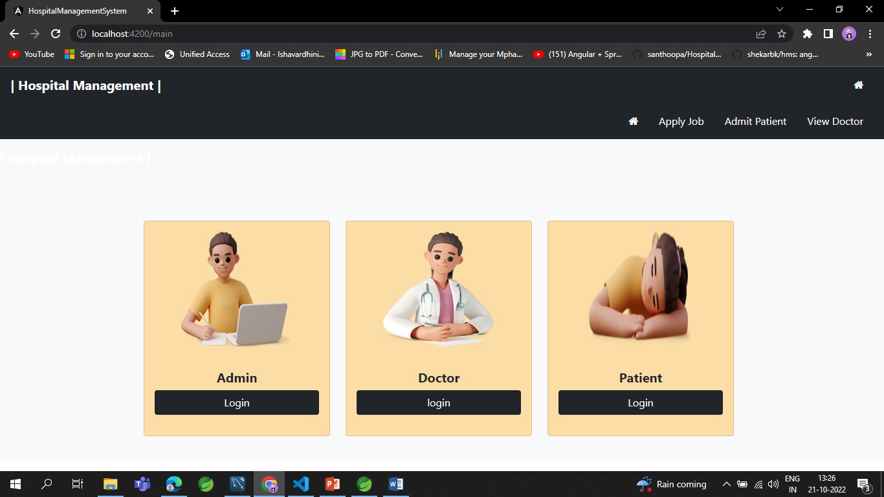
Home Page

Slide 9

Admin module
The admin module can signup their account and then login.
The admin module can register, view, reject, delete and approve those doctors who applied for job in their hospital.
Admin can admit, view, approve, reject and discharge patient when treatment is done.
Can generate and download Invoice according to medicine cost, room charge, doctor charge and other charge.
Can view, book, approve Appointment from patient.

Slide 10
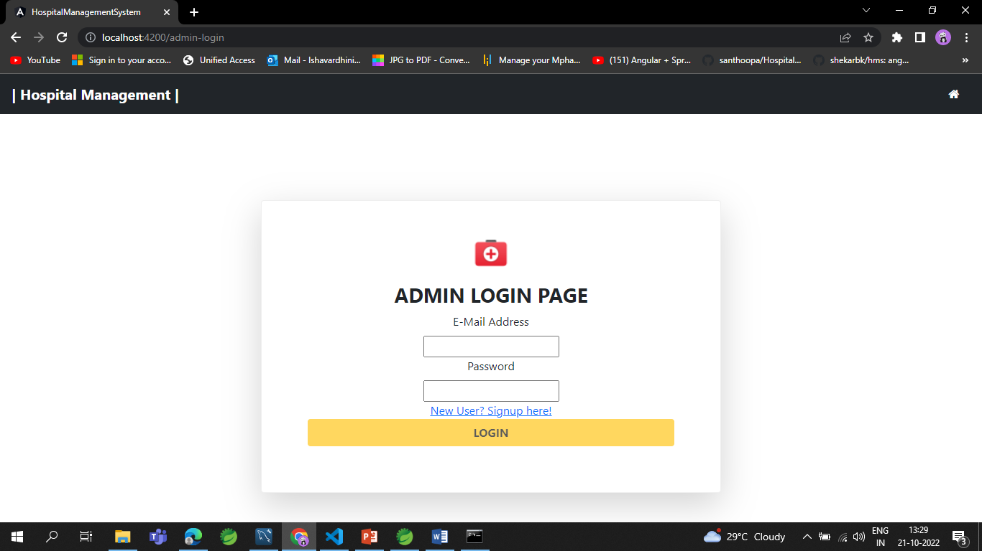
Admin Module

Slide 11
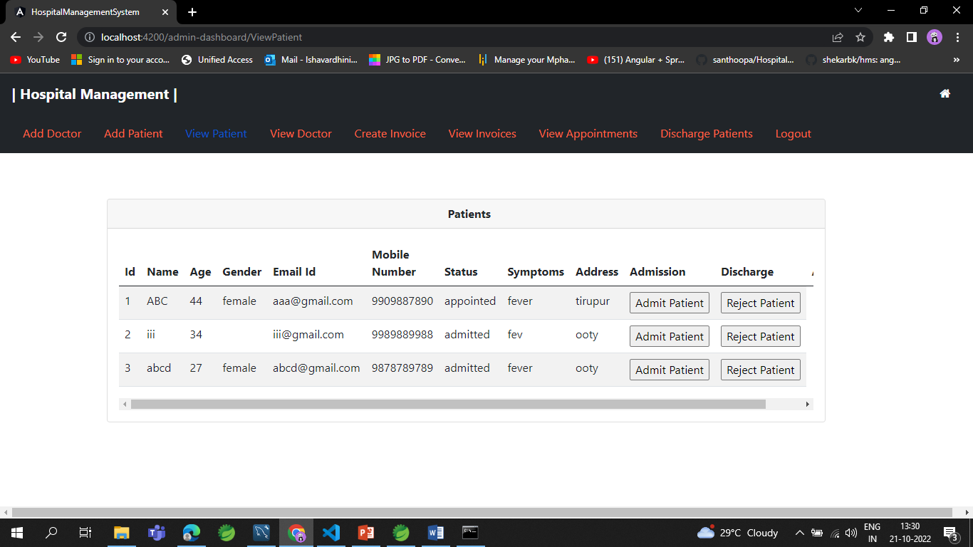
Admin Module

Slide 12

DOCTOR MODULE
Doctor can signup and then login.
Doctor can only view their patient details which assigned to that doctor by admin.
Can view their discharged patient list and Appointments.

Slide 13
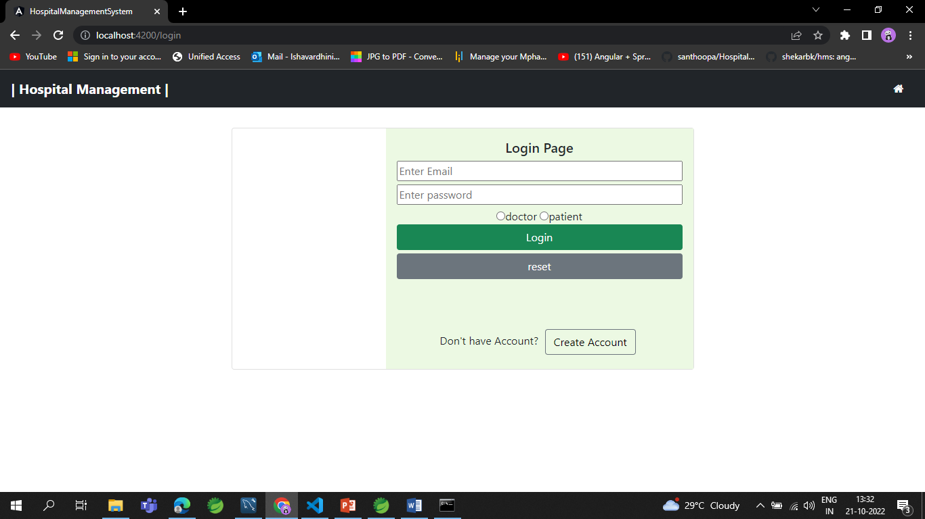
Doctor Module

Slide 14
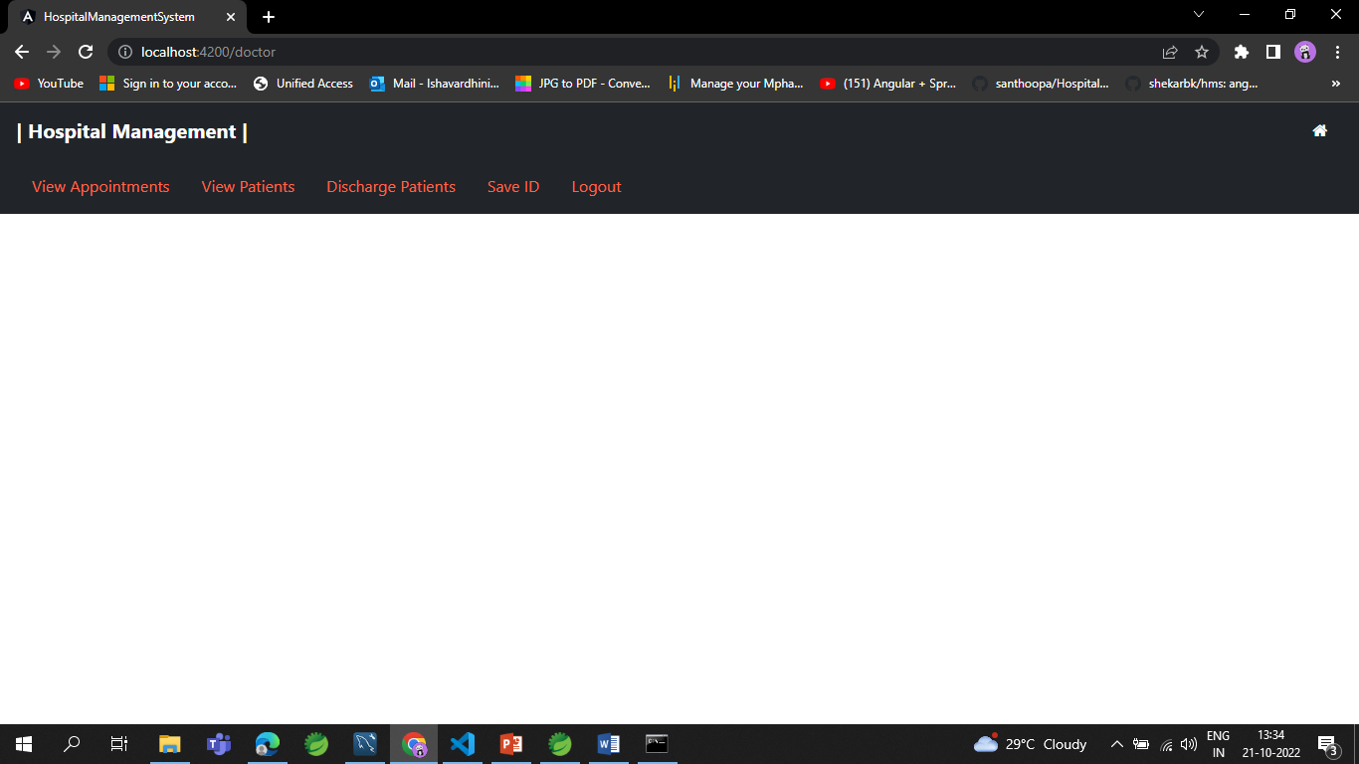
Doctor Module

Slide 15

PATIENT MODULE
Create account and then Login.
Can view assigned doctor's details.
Patient can book appointment and then view their appointment status.
Can view and download Invoice pdf after discharge.

Slide 16
Patient Module

Slide 17
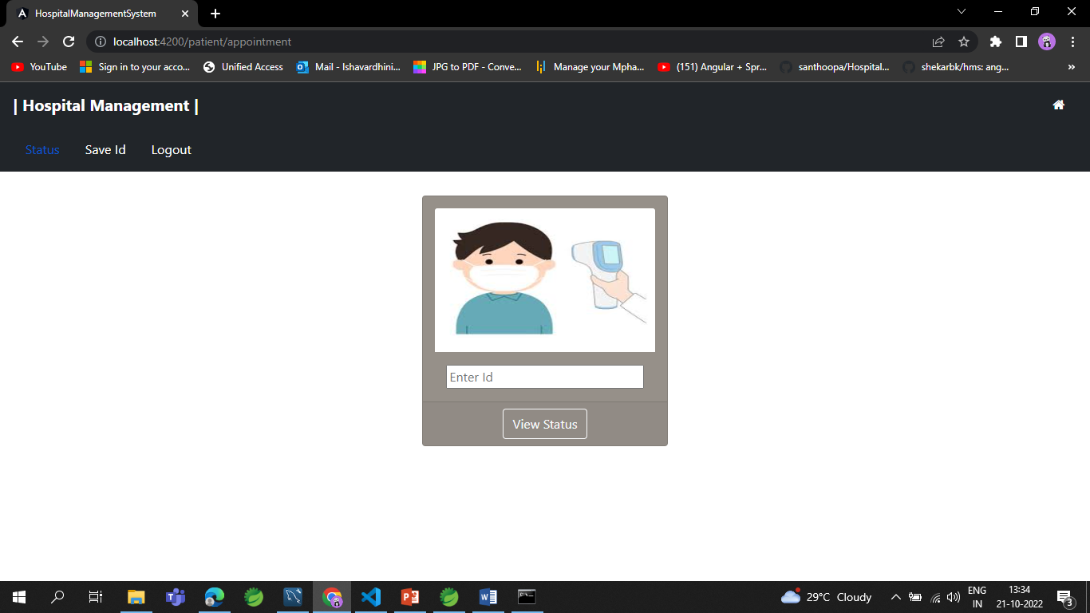
Patient module

Slide 18
ADVANTAGES:
Establish your hospital as technically advanced.
Patient self service.
Cost efficiency.
Less time consumption.
Maintain records and track every details.

Slide 19
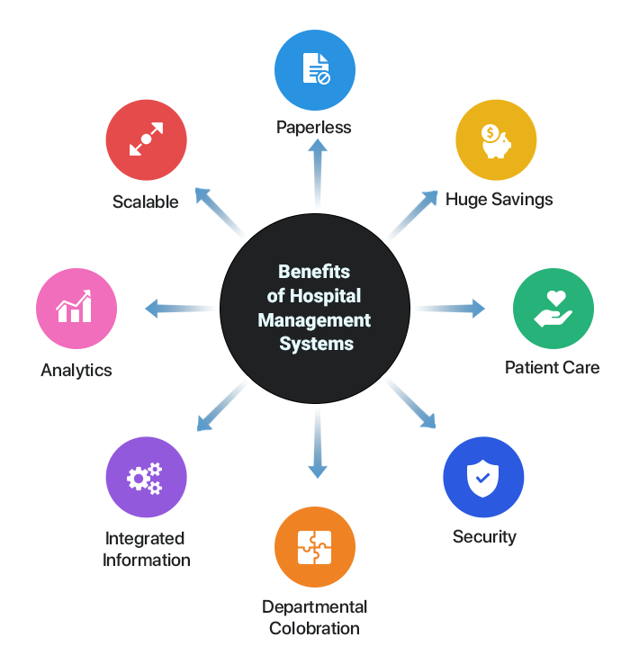

Slide 20

TOOLS AND TECHNOLOGIES USED
Front-End: Angular
Server-side: Spring Boot
Back-end: MYSQL
Server: Tomcat

Slide 21
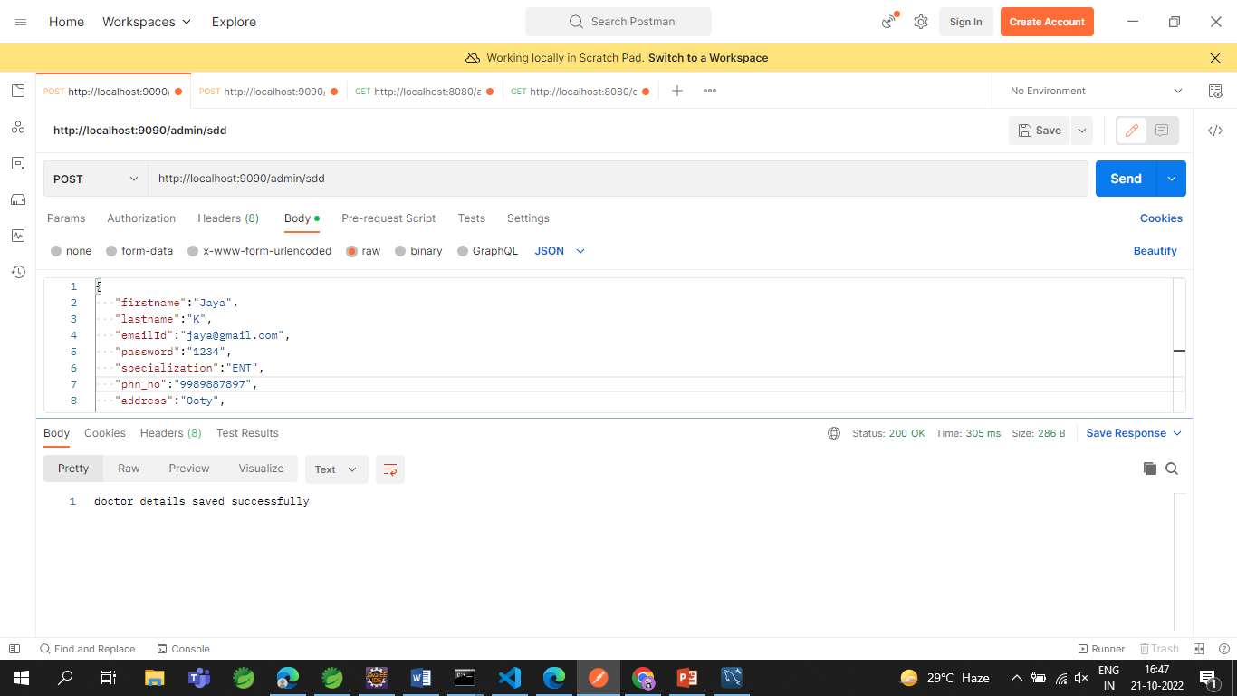
postman

Slide 22

SYSTEM REQUIREMENTS
The Basic System Requirements for Running this project are listed below:
Visual studio, STS, Postman and MySql to be installed to the system
1 GB Random Access Memory
200 MB of Free Space on Hard Disk
Microsoft Windows 8,10,11 or Linux or Equivalent OS
Web Browser (Microsoft Edge, Google Chrome)

Slide 23
Features available
Admin
Login
Create Admin Account
Doctor List
Patient List
Invoice
Doctor
Signup
Login
Appointment list
Discharged list
Patient
Signup
Login
Doctor details
Appointment status

Slide 24
FUTURE SCOPE OF HOSPITAL MANAGEMENT SYSTEM
The project Hospital Management system includes registration of patients, storing their details into the system, and also computerized billing in the pharmacy, and labs.
The software has the facility to give a unique id for every patient and stores the details of every patient and the staff automatically.
They providing such features to enables the user to include more comments into the system.

Slide 25



CONCLUSION
Hospital management system is all about the modernizing a hospital through use of technology.
Computers helps in it and take over the manual system for quick and easy functioning.
This hospital management system is a quite the reliable and is proven on many stages.
All the basic requirements of the hospital are provided in the hospital in order to manage it perfectly and large amount of data can also be stored.
It gives many facilities like searching for the detail of patient,billing facilities as well as the creation of test reports. So it;s a important system for modern days.

Slide 26
Bibliography
YouTube
www.stackoverflow.com
www.w3school.com
www.google.com
www.angular.io
https://www.partech.nl/nl/publicaties/2020/07/9-trending-best-practices-for-rest-api-development.com

Slide 27


